Slide 1
GNN
Chien-Hua, Chen

Slide 2
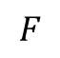
GNN
Spatial-based
Spectral-based
Feature Aggregation | Method
Sum | NN4G
Mean | DCNN, DGC, GraphSAGE
Weighted Sum | MoNET, GAT, GIN
LSTM | GraphSAGE
Max Pooling | GraphSAGE
ChebNet → GCN → HyperGCN
Component 1
Component 4
Orthonormal
Eigen Vector
Adjacency
…
$$F$$
Features
The amount of component
C1
C2
C3
C4
SUM/MEAN/MAX
Supervised classification
Semi-supervised learning
Representation learning (embedding): Graph InfoMax
Graph Generation: GraphVAE, MolGAN, …

Slide 3
Benchmark, Tasks and Dataset
Tasks
Semi-supervised node classification: Cora, CiteSeer, Pubmed
Graph Classification: PROTEINS, D&D, COLLAB
Link Prediction: NELL
Graph Representation Learning
Regression

Slide 4
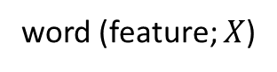
1. Node Prediction (Citation Network)
= transduction learning
AI
n.n.
prob.
GCN
algo.
pred.
AI
?
Have word 1?
to cite
Have word 1?
Chem.
Med.
Have word 2?
Have word 2?
n.n.
…
…
pred.
Article 1
Article 2
 | Cora | Citeseer | Pubmed
 | 2708 | 3327 | 19717
 | 5429 | 4732 | 44338
 | 1433 | 3703 | 500
Labels (Categories; Classes) | 7 | 6 | 3
Labeling rate | 0.052 | 0.036 | 0.003
article (node)
citation(edge)
Have word _?
word (feature; $X$)

Slide 5
1. Node Prediction (Knowledge Graph)
= transduction learning
Taiwan
???
Taipei
Canada
country
Skydome
country
City stadium
 | NELL
nodes | 65755
edges | 266144
features | 5414
Labels (Categories; Classes) | 210
Labeling rate | 0.052
Toronto
Home Town
Maple Leaf
hospital
Sunnybrook
NELL Dataset

Slide 6
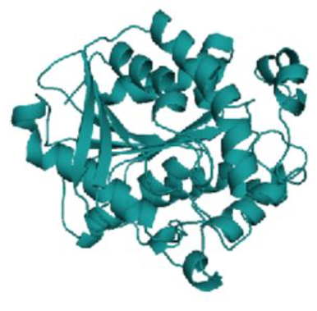
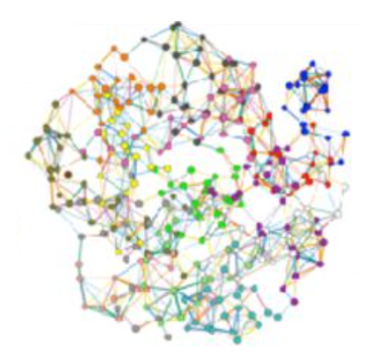
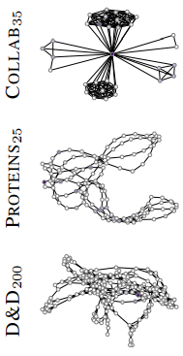
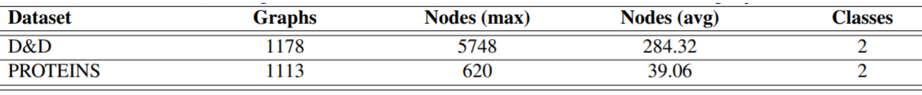
2. Graph Prediction ( Protein Structures )
= inductive learning
Graph Prediction
enzymes
non-enzymes
a.a.
????
Enzyme

Slide 7
2.Graph Prediction (Researcher’s Collaboration)
= inductive learning
Graph Prediction
1. High Energy Physics
2. Condensed Matter Physics
3. Astro Physics
researcher
collaboration

Slide 8
1. Traditional Graph Convolutional Networks
Semi-Supervised Classification with Graph Convolutional Networks (2017.9) Author: Kipf, Thomas N.; Welling, Max (University of Amsterdam)
Publication: eprint arXiv:1609.02907

Slide 9
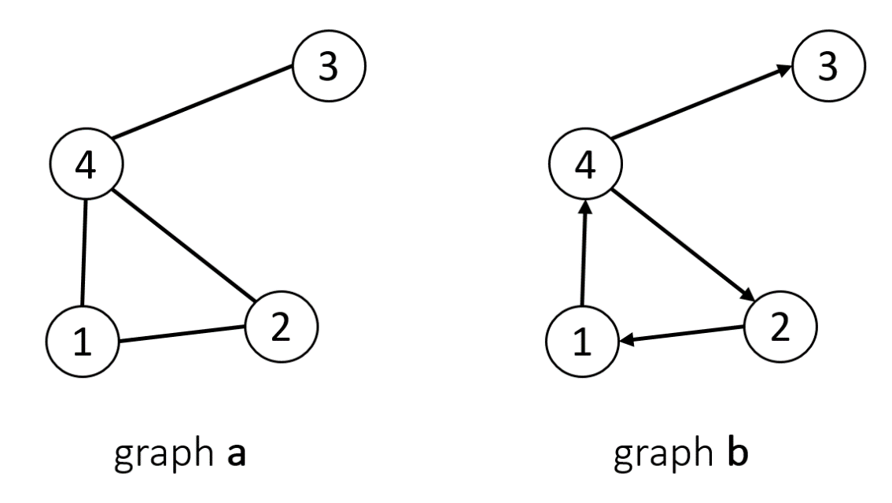
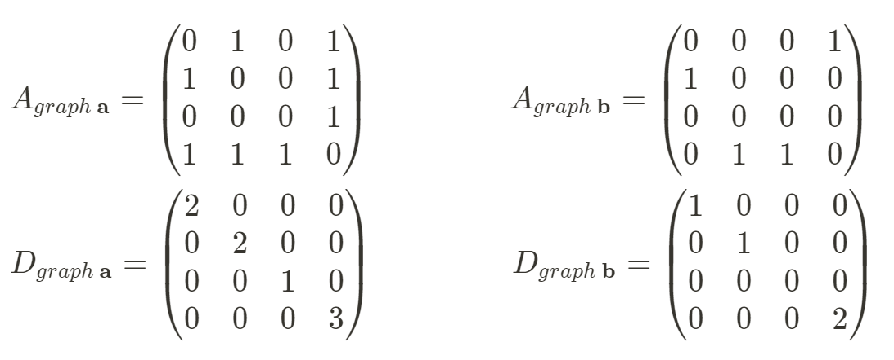
Graph
Undirected graphs
Directed graphs
Laplacian
1. Adjacency matrix (A)
2. Degree matrix (D)
(Diagonal)

Slide 10
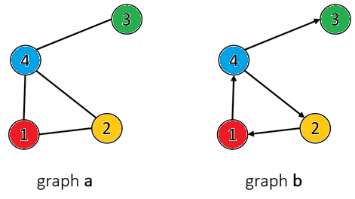
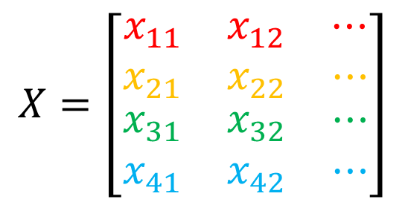
Graph
$$X=\left[\begin{matrix}\begin{matrix}x_{11} & x_{12} & ⋯\end{matrix} \\ \begin{matrix}x_{21} & x_{22} & ⋯\end{matrix} \\ \begin{matrix}\begin{matrix}x_{31} & x_{32} & ⋯\end{matrix} \\ \begin{matrix}x_{41} & x_{42} & ⋯\end{matrix}\end{matrix}\end{matrix}\right]$$
3. Feature matrix (X)
# of nodes
# of independent variables

Slide 11
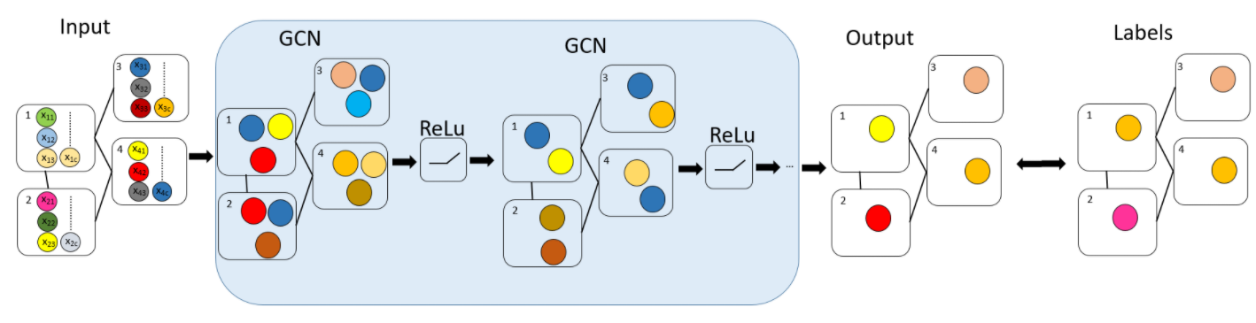
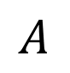
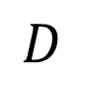
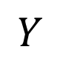
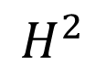
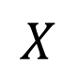



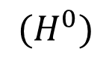

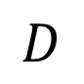
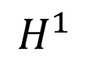
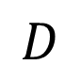
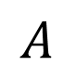
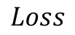
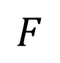
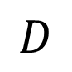

GCN Layer
Input Layer
Hidden Layer
Output Layer
Label
$$A$$
$$A$$
$$A$$
$$⋯$$
$$A$$
$$D$$
$$D$$
$$D$$
$$⋯$$
$$D$$
$$X$$
$$H^{1}$$
$$H^{2}$$
$$⋯$$
$$F$$
$$Loss$$
$$Y$$
$$(H^{0})$$
Feature Propagation
=
Prediction

Slide 12
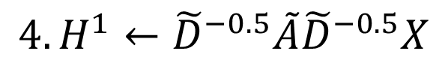
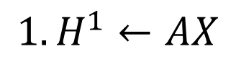
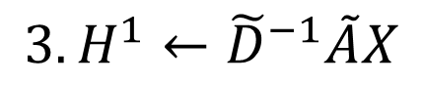
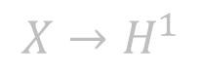
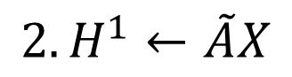
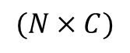
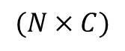
Feature Propagation
$$X→H^{1}$$
$$1. H^{1}←AX$$
SUM
Not concern central node itself
$$2.H^{1}←\tilde{A}X$$
SUM
Exploding Gradients
(Normalization)
$$3.H^{1}←{\tilde{D}}^{−1}\tilde{A}X$$
1
~
1
Mean
1
Not concern neighbor’s neighbor
1
3
= Regularization Laplacian
= Laplacian Smoothing
~
3
(Normalized Laplacian)
2
4
$$4. H^{1}←{\tilde{D}}^{−0.5}\tilde{A}{\tilde{D}}^{−0.5}X$$
$$(N×C)$$
$$(N×C)$$
Mean
no dimension reduction

Slide 13
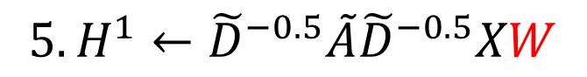

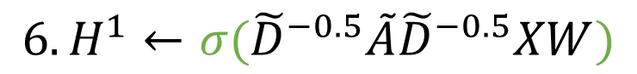

Feature Propagation
$$X→H^{1}$$
$$5. H^{1}←{\tilde{D}}^{−0.5}\tilde{A}{\tilde{D}}^{−0.5}XW$$
$$W$$
Linear Combination
(Dimension Reduction)
Feature 1, Feature 2, …, Feature C
New Feature 1, …, New Feature S
(S < C)
$$6. H^{1}←σ({\tilde{D}}^{−0.5}\tilde{A}{\tilde{D}}^{−0.5}XW)$$
Nonlinearity ↑
$$σ$$
Activation Function
New Feature 1, …, New Feature S
New Feature 1, …, New Feature S

Slide 14
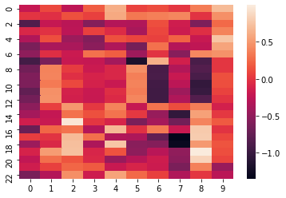
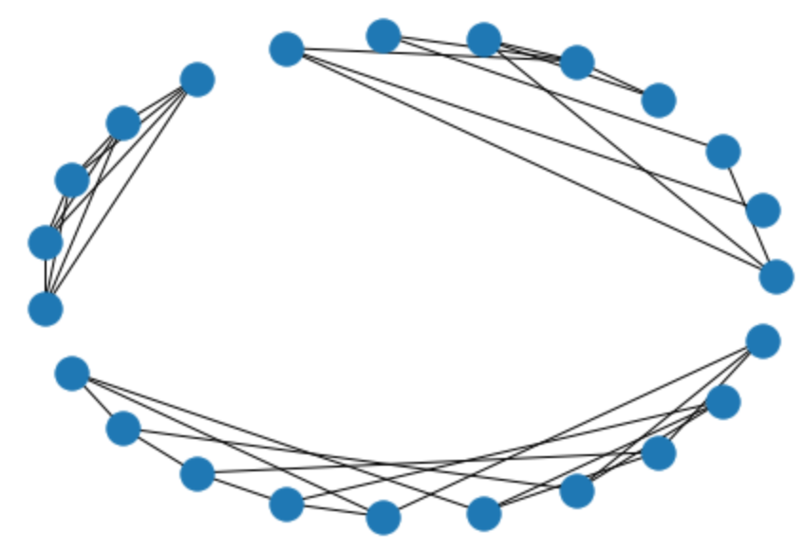
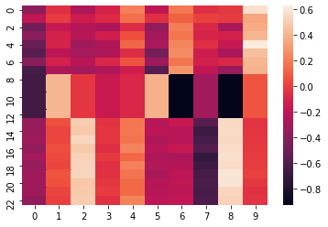
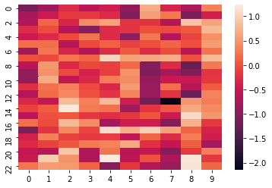
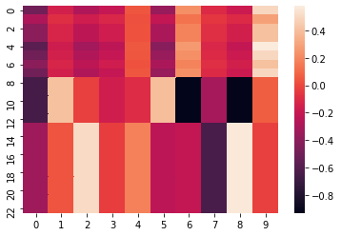
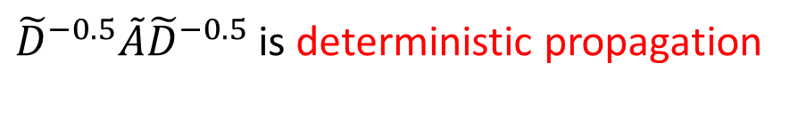
${\tilde{D}}^{−0.5}\tilde{A}{\tilde{D}}^{−0.5}$ is deterministic propagation
1 time propagation
graph
3 times propagation
nodes
6 times propagation
Over-smooth
features

Slide 15
GCN Layer
2-layer GCN in this paper! It cannot be deep.
Input Layer
Hidden Layer
Output Layer
Label
$$A$$
$$A$$
$$A$$
$$⋯$$
$$A$$
$$D$$
$$D$$
$$D$$
$$⋯$$
$$D$$
$$X$$
$$H^{1}$$
$$H^{2}$$
$$⋯$$
$$F$$
$$Y$$
=

Slide 16
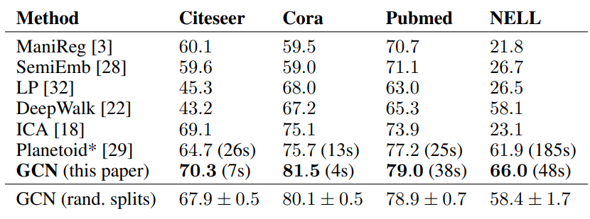
Performance
Transduction Learning

Slide 17
Restriction
Poor performance in Inductive Learning.
why? (GCN cannot be deep, so it highly depends on graph local structure.)
→Need Coarsen, GraphSAGE, LGCL, GATs
Poor performance in Direct Graph (有向圖).
→Need Learnable weight for feature propagation (LGCL , GATs)
Because of over-smooth when model is deep, it should be shallow.
→ResGCN, DenseGCN, Cluster GCN, …
Because Laplacian is deterministic propagation, GCN highly depends on neighbor and graph structure. Hence, new features are easily disturbed by potential noise such as adversarial perturbations.
→Graph-pooling (LGCL, G-U-Nets)
→Perturbation method (dropout, DropEdge, DropNode)

Slide 18
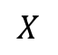
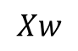
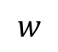

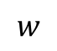
code – create GC Layer
import math
import torch
from torch.nn.parameter import Parameter
from torch.nn.modules.module import Module
torch.nn.modules.module.Module
torch.nn.parameter.Parameter
super
class GraphConvolution(Module):
def __init__(self, in_features, out_features, bias=True):
super(GraphConvolution, self).__init__()
self.in_features = in_features
self.out_features = out_features
self.weight = Parameter(torch.FloatTensor(in_features, out_features))
if bias:
self.bias = Parameter(torch.FloatTensor(out_features))
else:
self.register_parameter('bias', None)
self.reset_parameters()
def reset_parameters(self):
stdv = 1. / math.sqrt(self.weight.size(1))
self.weight.data.uniform_(-stdv, stdv)
if self.bias is not None:
self.bias.data.uniform_(-stdv, stdv)
def forward(self, input, adj):
support = torch.mm(input, self.weight)
output = torch.spmm(adj, support)
if self.bias is not None:
return output + self.bias
else:
return output
$$w$$
in_features
out_features
.reset_parameters
.forward
Hidden Layer
$$w$$
.reset_parameters
$$w$$
$$X$$
.forward
$$Xw$$

Slide 19
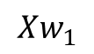
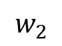
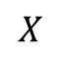
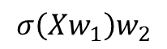
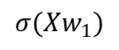
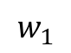
code – create GCN
import torch.nn as nn
import torch.nn.functional as F
class GCN(nn.Module):
def __init__(self, nfeat, nhid, nclass, dropout):
super(GCN, self).__init__()
self.gc1 = GraphConvolution(nfeat, nhid)
self.gc2 = GraphConvolution(nhid, nclass)
self.dropout = dropout
def forward(self, x, adj):
x = F.relu(self.gc1(x, adj))
x = F.dropout(x, self.dropout, training=self.training)
x = self.gc2(x, adj)
return F.log_softmax(x, dim=1)
model = GCN(nfeat=features.shape[1],
nhid=args.hidden,
nclass=labels.max().item() + 1,
dropout=args.dropout)
F.relu
F.dropout
F.log_softmax
$$w_{1}$$
ReLU
dropout
$$w_{2}$$
softmax
$$X$$
$$Xw_{1}$$
$$σ(Xw_{1})$$
$$σ\left(Xw_{1}\right)w_{2}$$
Predictions
GCN Model

Slide 20














code – Training
import torch.optim as optim
def train(epoch):
optimizer = optim.Adam(model.parameters(), lr=args.lr,
weight_decay=args.weight_decay)
model.train()
optimizer.zero_grad()
output = model(features, normalized_adj)
loss_train = F.nll_loss(output[idx_train], labels[idx_train])
def laplacian(mx):
degree = np.array(mx.sum(1))
d_hat = sp.diags(np.power(degree, -0.5).flatten())
Laplacian_mx = d_hat.dot(mx).dot(d_hat)
return laplacian_mx
loss_train.backward()
optimizer.step()
$$X$$
laplacian
F.dropout
F.nll_loss
$$∇_{w_{1}}$$
0
$$∇_{w_{2}}$$
gradient
0
$${\tilde{D}}^{−0.5}\tilde{A}{\tilde{D}}^{−0.5}X$$
$$w_{1}$$
ReLU
dropout
$$w_{2}$$
softmax
$$X$$
$$Xw_{1}$$
$$σ(Xw_{1})$$
$$σ\left(Xw_{1}\right)w_{2}$$
Predictions
labels
$$σ({\tilde{D}}^{−0.5}\tilde{A}{\tilde{D}}^{−0.5}Xw_{1})$$
$$σ({\tilde{D}}^{−0.5}\tilde{A}{\tilde{D}}^{−0.5}{Xw}_{1})w_{2}$$
$$softmax(σ\left({\tilde{D}}^{−0.5}\tilde{A}{\tilde{D}}^{−0.5}{Xw}_{1}\right)w_{2})$$
$${\tilde{D}}^{−0.5}\tilde{A}{\tilde{D}}^{−0.5}Xw_{1}$$
Loss Function
GCN Model

Slide 21







code – Testing
def accuracy(output, labels):
preds = output.max(1)[1].type_as(labels)
correct = preds.eq(labels).double()
correct = correct.sum()
return correct / len(labels)
def test():
model.eval()
output = model(features, normalized_adj)
loss_test = F.nll_loss(output[idx_test], labels[idx_test])
acc_test = accuracy(output[idx_test], labels[idx_test])
accuracy
$$X$$
F.dropout
F.nll_loss
laplacian
$$w_{1}$$
ReLU
dropout
$$w_{2}$$
softmax
$$X$$
$$Xw_{1}$$
$$σ(Xw_{1})$$
$$σ\left(Xw_{1}\right)w_{2}$$
Predictions
labels
Loss

Slide 22

code – Results (Cora)
Training
Testing
Loss = 0.7174
accuracy = 0.836

Slide 23


Deeper propagation
Hidden 3
Hidden 2
Hidden 1
$←$Can’t not find global information!
Input

Slide 24






Deeper propagation
Semi-Supervised Classification with Graph Convolutional Networks (2017.9)
1. Residual connection
$$H^{l+1}←σ\left({\tilde{D}}^{−0.5}\tilde{A}{\tilde{D}}^{−0.5}H^{l}W\right)+H^{l}$$
+
$$W$$
$$σ$$
DeepGCNs: Can GCNs Go as Deep as CNNs? (2019.8)
2. Dense connection
$H^{l+1}←T(σ\left({\tilde{D}}^{−0.5}\tilde{A}{\tilde{D}}^{−0.5}H^{l}W\right), H^{l}$)
concatenate
$$W$$
$$σ$$

Slide 25




Deeper propagation
Cluster-GCN: An Efficient Algorithm for Training Deep and Large Graph Convolutional Networks
3. Cluster GCN
3-1. Enhance central node’s feature
$$H^{l+1}=σ(({\tilde{D}}^{−0.5}\tilde{A}{\tilde{D}}^{−0.5}+I)H^{l}W^{l})$$
3-2. New method for normalization
Performance in inductive learning
$$\tilde{A}={\left(D+I\right)}^{−1}(A+I)$$
$$H^{l+1}=σ((\tilde{A}+\text{λ}∙diag\left(\tilde{A}\right))H^{l}W^{l})$$

Slide 26
2. Graph attention networks (GAT)
Graph Attention Networks (2017.10) Author: Petar Veličković, Guillem Cucurull, Arantxa Casanova, Adriana Romero, Pietro Liò, Yoshua Bengio
(University of Cambridge (Trinity College-CS)) (Mila - Quebec AI Institute)
Publication: eprint arXiv:1710.10903

Slide 27



Learnable Weights in Feature Transfer
Correlation (attention coefficients) between their feature vectors
High correlation between $x_{i} and x_{j}→$ higher weight ($α_{ij}$)
$α_{ij}$is different from $α_{ji}$
Learnable
Learnable

Slide 28




GAT
0.2
0.1
0.3
$$α_{ii}$$
0.4
$$α_{ii}$$

Slide 29
















GAT
multi-head attention mechanism
GAT 0
$$α_{ii}$$
GAT 1
$$x_{1}$$
…
$$x_{1}$$
$$α_{ii}$$
Concat
GAT out
$$x_{i}$$
$$x_{3}$$
$$x_{i}$$
$$x_{3}$$
$$x_{2}$$
$$α_{ii}$$
$$x_{2}$$
GAT 2
softmax
$$α_{ii}$$
A
$$x_{1}$$
A
C
$$x_{i}$$
$$x_{3}$$
GAT 3
B
$$x_{2}$$
$$α_{ii}$$

Slide 30

Performance

Slide 31
Performance
10-fold cross validation
 | Cora | Citeseer | pubmed
GCN | 87.55% (±2.59%) | 70.80% (±2.26%) | 86.75% (±0.44%)
G-U-NET | 86.37% (±2.05%) | 72.83% (±3.55%) | 86.05% (±0.82%)
GAT | 89.06% (±1.46%) | 76.96% (±1.88%) | 85.88% (±0.76%)

Slide 32
















Time Complexity
 | Algorithm | Time Complexity | Space Complexity
GCN | $$h^{l+1}=ReLU\left({\tilde{D}}^{−0.5}\tilde{A}{\tilde{D}}^{−0.5}h^{l}θ \right)$$ | $$O(\left|V\right|FF^{′}+{|V|}^{2}F′)$$ | $$O({\left|V\right|}^{2}+|V|F+\left|V\right|F′)$$
GCN (sparse) | $$h^{l+1}=ReLU\left({\tilde{D}}^{−0.5}\tilde{A}{\tilde{D}}^{−0.5}h^{l}θ \right)$$ | $$O(\left|V\right|FF^{′}+|E|F′)$$ | $$O(\left|E\right|+|V|F+\left|V\right|F′)$$
GAT |  | Single-head:$O(\left|V\right|FF^{′}+{|V|}^{2}F′)$ Multi-head:$O(K\left|V\right|FF^{′}+K{|V|}^{2}F′)$ | $$O({\left|V\right|}^{2}F^{′}+|V|F+\left|V\right|F′)$$
GAT (sparse) |  | Single-head:$O(\left|V\right|FF^{′}+|E|F′)$ Multi-head:$O(K\left|V\right|FF^{′}+K|E|F′)$ | $$O(|E|F^{′}+|V|F+\left|V\right|F′)$$
$$O(|V|)$$
$$O(|V|FF′)$$
$$A$$
$${feature}_{in}$$
$${feature}_{out}$$
$$O(|V|F′)$$
$$O({|V|}^{2}F′)$$
$$O(|V|)$$
$$O(|V|FF′)$$
$$O(|V|F′)$$
$$O(|E|F′)$$
$$O({|V|}^{2}F′)$$
$$O(|V|FF′)$$
$$O(|E|F′)$$
$$O(|V|FF′)$$

Slide 33
 | Cora | Citeseer | Pubmed
|V| | 2708 | 3327 | 19717
|E| | 5429 | 4732 | 44338
F | 1433 | 3703 | 500
Time Complexity of GCN (sparse→dense) | 1x→2.9x | 1x→1.9x | 1x→40x
Time Complexity of GAT (sparse→dense) | 1x→2.9x | 1x→1.9x | 1x→40x
Space Complexity of GCN (sparse→dense) | 1x→2.8x | 1x→1.9x | 1x→40x
Space Complexity of GAT (sparse→dense) | 1x→40x | 1x→24x | 1x→97x
|V|↑, |E| ↓, F↓ → use sparse matrix!!!

Slide 34
Advantages
Excellent performance in inductive learning.(Because GATs depends on correlation of two nodes, not depends on graph structure.)
Excellent performance in direct graph.

Slide 35
Restriction
Time-consuming
Memory limitation

Slide 36
3. Learnable Graph Convolutional Layer (LGCL)
Large-Scale Learnable Graph Convolutional Networks (2018.8) Author: Gao, Hongyang; Wang, Zhengyang; Ji, Shuiwang (Texas A&M University)
Publication: eprint arXiv:1808.03965

Slide 37
Why use LGCL?
GCN
Feature transfer highly depends on graph structure. → Poor in inductive learning.
There is no trainable weight when feature transfer. → Poor in direct graph.
GATs
Time-consuming
Memory limitation

Slide 38

k-largest Node Selection

Slide 39

1-D Convolutional Neural Network

Slide 40

Advantages
Feature transfer according to rank of feature.
Higher value of feature × learnable weights for high value transfer
Lower value of feature × learnable weights for low value transfer
Low value may be ignore.

Slide 41


Sub-Graph Training on Large-Scale Data
BFS
Input
Whole graph
Sub-graph

Slide 42
Breadth First Search (BFS)
10
11
4
9
1
5
3
START
8
12
2
6
13
7
14
16
15

Slide 43



















Breadth First Search (BFS)
$$√$$
$$√$$
11
$$√$$
$$√$$
5
Initial Random
10
$$√$$
$$√$$
$$√$$
$$√$$
4
2
Second Random
$$√$$
Set Total = 15
Initial Random = 3
Second Random = 5
Third Random = 7
9
1
$$√$$
$$√$$
$$√$$
$$√$$
3
6
8
$$√$$
12
Third Random
$$√$$
15
$$√$$
7
$$√$$
13
$$√$$
$$√$$
14
Sub-graph

Slide 44






Performance
Transductive
Inductive
GATs
83.0$±$0.7%
72.5$±$0.7%
79.0$±$0.3%
GATs
0.973$±$0.002

Slide 45

LGCL v.s. GCN Layer

Slide 46

Sub-Graph v.s. Whole-Graph

Slide 47




How to set k in k-largest Node Selection
$$mean degree=4$$
$$mean degree=6$$
$$mean degree=5$$

Slide 48
4. Graph U-Nets
Graph U-Nets (2019.5) Author: Gao, Hongyang; Ji, Shuiwang (Texas A&M University)
Publication: eprint arXiv:1905.05178

Slide 49

gPool
Linear Combination → Feature Conclusion
or tanh
Trainable
Remain Top k nodes

Slide 50

G-U-Nets
G-U-Nets = gPool + GCN + gUnpool + GCN
encoder
decoder
Select meaningful nodes
Zero-padding
Feature transfer

Slide 51

Deep G-U-Nets
Traditional GCN

Slide 52


Graph Connectivity Augmentation

Slide 53





Performance
Transductive
LGCL
83.3$±$0.5%
73.0$±$0.6%
79.5$±$0.2%
Inductive

Slide 54

Network Depth of Graph U-Nets

Slide 55
5. Hierarchical GCN (H-GCN)
Hierarchical Graph Convolutional Networks for Semi-supervised Node Classification (2019.6) Author: Hu, Fenyu; Zhu, Yanqiao; Wu, Shu; Wang, Liang; Tan, Tieniu (中國科學院自動化研究所)
Publication: eprint arXiv:1902.06667

Slide 56

H-GCN Architecture
Coarsening
Refining
Graph Embedding
softmax
Output
Input

Slide 57



Graph Coarsening
D=3
A
A
A
1
1
1
1
2
$$s_{AC}=\frac{1}{\sqrt{3×4}}$$
1
2
A
SEG
SSG
2
SSG
B
1
C
1
D
C
2
BD
C
BD
step 1
<
D=4
step 2
BD
1
1
$$s_{CE}=\frac{1}{\sqrt{4×1}}$$
1
CE
E
E
E
D=1
$$similarity\left(s_{ij}\right)=\frac{edge weight between i \& j}{\sqrt{D_{i}×D_{j}}}$$

Slide 58





Hidden Node Embedding
A
BD
CE
A
$$grouping matrix\left(M\right)=\left[\begin{matrix}1 & 0 & 0 \\ \begin{matrix}0 \\ \begin{matrix}0 \\ 0 \\ 0\end{matrix}\end{matrix} & \begin{matrix}1 \\ \begin{matrix}0 \\ 1 \\ 0\end{matrix}\end{matrix} & \begin{matrix}0 \\ \begin{matrix}1 \\ 0 \\ 1\end{matrix}\end{matrix}\end{matrix}\right]$$
B
A
C
D
A
E
B
C
D
CE
BD
E
$$A_{1}=\left[\begin{matrix}0 & 1 & 1 & 1 & 0 \\ 1 & 0 & 1 & 0 & 0 \\ 1 & 1 & 0 & 1 & 1 \\ 1 & 0 & 1 & 0 & 0 \\ 0 & 0 & 1 & 0 & 0\end{matrix}\right]$$
$$A_{2}=M^{T}A_{1}M$$
$$H_{2}=M^{T}∙ReLU({\tilde{D}}_{1}^{−0.5}{\tilde{A}}_{1}{\tilde{D}}_{1}^{−0.5}H_{1}W_{1})$$
Hidden Node Embedding
$$H_{1}$$

Slide 59



Node Weight Embedding
1 node
p-dim
A
$$V= \left[\begin{matrix}θ_{11} & θ_{12} & ⋯ \\ θ_{21} & θ_{22} & ⋯\end{matrix}\right]$$
1 node
CE
BD
2 node
2 node
2 node
d-dim
$$H_{2}= \left[\begin{matrix}h_{A1} & h_{A2} & ⋯ \\ h_{(BD)1} & h_{(BD)2} & ⋯ \\ h_{(CE)1} & h_{(CE)2} & ⋯\end{matrix}\right]$$
A
$$H_{2}= \left[\begin{matrix}h_{A1} & h_{A2} & ⋯ & θ_{11} & θ_{12} & ⋯ \\ h_{\left(BD\right)1} & h_{\left(BD\right)2} & ⋯ & θ_{21} & θ_{22} & ⋯ \\ h_{\left(CE\right)1} & h_{\left(CE\right)2} & ⋯ & θ_{21} & θ_{22} & ⋯\end{matrix}\right]$$
concatenate
BD
CE

Slide 60



Graph Refining
A
BD
CE
A
$$M=\left[\begin{matrix}1 & 0 & 0 \\ \begin{matrix}0 \\ \begin{matrix}0 \\ 0 \\ 0\end{matrix}\end{matrix} & \begin{matrix}1 \\ \begin{matrix}0 \\ 1 \\ 0\end{matrix}\end{matrix} & \begin{matrix}0 \\ \begin{matrix}1 \\ 0 \\ 1\end{matrix}\end{matrix}\end{matrix}\right]$$
B
C
D
A
A
E
B
C
D
CE
BD
E
refine
residual connection
$$H_{2}$$
$$H_{3}=M∙ReLU\left({\tilde{D}}_{2}^{−0.5}{\tilde{A}}_{2}{\tilde{D}}_{2}^{−0.5}H_{2}W_{2}\right)+ReLU({\tilde{D}}_{1}^{−0.5}{\tilde{A}}_{1}{\tilde{D}}_{1}^{−0.5}H_{1}W_{1})$$
Previous graph’s convolution
Previous same graph’s convolution

Slide 61


H-GCN Architecture
One Channel:
$$G_{i}=ReLU({\tilde{D}}_{i}^{−0.5}{\tilde{A}}_{i}{\tilde{D}}_{i}^{−0.5}H_{i}W_{i})$$
Multiple Channel:
$$G_{i}=\sum_{j=1}^{c}{w_{j}G_{i}^{j}}$$
Explore different feature subspaces

Slide 62







Performance
LGCL
83.3$±$0.5%
73.0$±$0.6%
79.5$±$0.2%
G-U-Nets
84.4$±$0.6%
73.2$±$0.5%
79.6$±$0.2%

Slide 63
6. Hierarchical GCN (Hi-GCN) for graph embedding
Hi-GCN: A hierarchical graph convolution network for graph embedding learning of brain network and brain disorders prediction
(2020.11) Author: Hao Jiang, Peng Cao, MingYi Xu, Jinzhu Yang, Osmar Zaiane (中國東北大學CSE)
Publication: Computers in Biology and Medicine 127 (2020) 104096

Slide 64





Hi-GCN Architecture
…
: ROIs
Person’s corr.
between ROIs
Brain network embedding
Coarsen
Coarsen
Feature: Time series signal
GCN
softmax
…
Graph Kernel
Person’s corr.
between ROIs
Coarsen
Coarsen
f-GCN
p-GCN

Slide 65




Graph Kernel
$$0<S_{I}≤1$$
$$S_{I}$$
Feature Space
$$S_{I}=\frac{\sum_{a=1}^{M}{\sum_{b=1}^{M}{w_{a}^{i}w_{b}^{j}𝒦(x_{a}^{i},x_{b}^{j})}}}{\sum_{M}^{n_{i}}{w_{a}^{i}}\sum_{b=1}^{M}{w_{b}^{j}}}$$
Similarity
$$S_{I}=0$$

Slide 66
Learning Strategy
1. Two-step
f-GCN
Loss
embedding
p-GCN
Loss
prediction
2. Jointly Learning
embedding
f-GCN
p-GCN
Loss
prediction
2. Pre-training
embedding
f-GCN
Loss
f-GCN
p-GCN
Loss
weight

Slide 67


Performance

Slide 68

Performance (+ non-image information)
+ gender
+ acquisition site
+ gender
+ age

Slide 69

Method of connectivity

Slide 70
7. Graph Random Neural Network for Semi-Supervised Learning on Graphs
Graph Random Neural Network for Semi-Supervised Learning on Graphs (2020.10) Author: Feng, Wenzheng; Zhang, Jie; Dong, Yuxiao; Han, Yu; Luan, Huanbo; Xu, Qian; Yang, Qiang; Kharlamov, Evgeny; Tang, Jie
(中國清華大學CS)
Publication: eprint arXiv:2005.11079

Slide 71




DropNode
Augmented Feature
$$Bernoulli(1−δ)$$
mixed-order
propagation
0
0.1
1
0
0.7
1
1
0.2
0
1
0.8
1
1
0.1
0
0
MLP
0.2
1
randam
propagation
or
…
…
…
…
GAT
…
$$ℒ_{sup}$$
or
GCN
0.1
1
0.7
1
0
0.2
0
0
0.8
1
1
0.1
0
1
0.2
1
1
0
consistency
regularization
$$ℒ_{con}$$
$$\min\left(ℒ_{sup}+ℒ_{con}\right)$$

Slide 72


Advantage
Robust
Relieve over-smoothing
Good Generalization Capacity

Slide 73

Performance

Slide 74































NN4G (Neural Network for Graph)
$${ x}_{1}$$
$${ x}_{2}$$
$${ x}_{4}$$
$${ x}_{5}$$
$${ x}_{3}$$
$$∙{\overline{w}}_{0}$$
$${ h}_{1}^{0}$$
$${=\overline{w}}_{0}∙x_{1}$$
$${ h}_{2}^{0}$$
$$X_{0}=MEAN(h^{0})$$
Input
(hidden layer 0)
$${ h}_{4}^{0}$$
$$w_{0}$$
$${ h}_{5}^{0}$$
$${ h}_{3}^{0}$$
$$propagation$$
$${ h}_{1}^{1}$$
$$={\hat{w}}_{1,1}\left(h_{2}^{0}+h_{3}^{0}+h_{4}^{0}\right)+h_{1}^{0}$$
Readout
$${ h}_{2}^{1}$$
$$w_{1}$$
Input
(hidden layer 1)
$${ h}_{4}^{1}$$
$$X_{1}=MEAN(h^{1})$$
+
$$y$$
$${ h}_{5}^{1}$$
$${ h}_{3}^{1}$$
(Inductive Learning)
$$w_{2}$$
$${ h}_{1}^{2}$$
Input
(hidden layer 2)
$${ h}_{2}^{2}$$
$${ h}_{4}^{2}$$
$$X_{2}=MEAN(h^{2})$$
$${ h}_{5}^{2}$$
$${ h}_{3}^{2}$$

Slide 75


















DCNN (Diffusion-Convolution Neural Network)
$${ x}_{1}$$
$${ x}_{2}$$
$${ x}_{4}$$
$${ x}_{5}$$
$${ x}_{3}$$
$${ h}_{1}^{0}$$
$$=w_{1}^{0}∙MEAN\left(x_{i}|d\left(1,i\right)=1\right)$$
$${ h}_{2}^{0}$$
$$H^{0}$$
Input
(hidden layer 0)
$${ h}_{4}^{0}$$
$${ h}_{5}^{0}$$
$${ h}_{3}^{0}$$
$${ h}_{1}^{0}$$
$${ h}_{1}^{1}$$
$$×$$
$$W$$
$$=y_{1}$$
$$=w_{1}^{1}∙MEAN\left(x_{i}|d\left(1,i\right)=2\right)$$
$$⋮$$
$${ h}_{1}^{1}$$
$${ h}_{2}^{1}$$
$${ h}_{1}^{k}$$
Input
(hidden layer 1)
$$H^{1}$$
(Transduction Learning)
$${ h}_{4}^{1}$$
$${ h}_{5}^{1}$$
$${ h}_{3}^{1}$$
…
$$=w_{1}^{k−1}∙MEAN\left(x_{i}|d\left(1,i\right)=k\right)$$
$$H^{k−1}$$

Slide 76



DGC (Diffusion Graph Convolution)
$${ x}_{1}$$
$${ x}_{2}$$
$${ x}_{4}$$
$${ x}_{5}$$
$${ x}_{3}$$
$${ h}_{1}^{0}$$
$$=w_{1}^{0}∙MEAN\left(x_{i}|d\left(1,i\right)=1\right)$$
$${ h}_{2}^{0}$$
$$H^{0}$$
Input
(hidden layer 0)
$${ h}_{4}^{0}$$
$${ h}_{5}^{0}$$
$${ h}_{3}^{0}$$
$$+$$
embedding
$$H$$
$${ h}_{1}^{1}$$
$$=w_{1}^{1}∙MEAN\left(x_{i}|d\left(1,i\right)=2\right)$$
$${ h}_{2}^{1}$$
$$H^{1}$$
Input
(hidden layer 1)
$${ h}_{4}^{1}$$
$${ h}_{5}^{1}$$
$${ h}_{3}^{1}$$
$$+$$
…
$$=w_{1}^{k−1}∙MEAN\left(x_{i}|d\left(1,i\right)=k\right)$$
$$H^{k−1}$$

Slide 77
MoNET (Mixture Model Networks)

Slide 78
GraghSAGE

Slide 79
GIN (Graph Isomorphism Network)

Slide 80





























Spectral Graph Theory
$$c^{2}$$
$Laplacian \left(L\right)=D−A$
c
$$−2cd$$
2
$x^{T}Lx=\left[\begin{matrix}a & b & c & d\end{matrix}\right]L\left[\begin{matrix}a \\ b \\ c \\ d\end{matrix}\right]=\left[\begin{matrix}a & b & c & d\end{matrix}\right]\left(D−A\right)\left[\begin{matrix}a \\ b \\ c \\ d\end{matrix}\right]={\left(a−b\right)}^{2}+{\left(a−d\right)}^{2}+{\left(c−d\right)}^{2}+{\left(b−d\right)}^{2}≥0$
→ $Laplacian \left(L\right) is semi −positive definite$
$$3d^{2}$$
d
3
$$−2ad$$
$$−2bd$$
a
b
0
1
$$2b^{2}$$
$$2a^{2}$$
$$−2ab$$
2. $L=UΛU^{T} (spectral decomposition)$
$${ u}_{0}$$
$${ u}_{1}$$
$${ u}_{2}$$
$${ u}_{3}$$
$${ λ}_{0}$$
$$≥0$$
$${ u}_{0}$$
$$=$$
$${ λ}_{1}$$
$${ u}_{1}$$
$${ λ}_{2}$$
$${ u}_{2}$$
$${ λ}_{3}$$
$${ u}_{3}$$
$$L$$
$$U$$
$$Λ$$
$$U^{T}$$
Orthonormal Basis

Slide 81




Spectral Graph Theory
$$Λ=\left[\begin{matrix}0 & 0 & 0 & 0 \\ 0 & 1 & 0 & 0 \\ 0 & 0 & 3 & 0 \\ 0 & 0 & 0 & 4\end{matrix}\right]$$
Find basis
$$L=\left[\begin{matrix}2 & −1 & 0 & −1 \\ −1 & 2 & 0 & −1 \\ 0 & 0 & 1 & −1 \\ −1 & −1 & −1 & 3\end{matrix}\right]=UΛU^{T}$$
2
3
$$U=\left[\begin{matrix}0.5 & −0.41 & 0.71 & −0.29 \\ 0.5 & −0.41 & −0.71 & −0.29 \\ 0.5 & 0.82 & 0 & −0.29 \\ 0.5 & 0 & 0 & 0.87\end{matrix}\right]$$
0
1
$$λ$$ | 0 | 1 | 3 | 4
$$u$$ | $$\left[\begin{matrix}0.5 \\ 0.5 \\ 0.5 \\ 0.5\end{matrix}\right]$$ | $$\left[\begin{matrix}−0.41 \\ −0.41 \\ 0.82 \\ 0\end{matrix}\right]$$ | $$\left[\begin{matrix}0.71 \\ −0.71 \\ 0 \\ 0\end{matrix}\right]$$ | $$\left[\begin{matrix}−0.29 \\ −0.29 \\ −0.29 \\ 0.87\end{matrix}\right]$$
basis
3
3
3
3
2
2
2
2
1
0
1
0
1
1
0
0

Slide 82




Spectral Graph Theory
Graph Fourier Transform
Orthonormal basis
$$\hat{x} = U^{T}x$$
3.5
0.5 0.5 0.5 0.5
4
-5.74
$$=$$
-0.41 -0.41 0.82 0
4
0
0.71 -0.71 0 0
-3
0.29
-0.29 -0.29 -0.29 0.87
2
Spectral Domain
Spatial Domain (Vertex Domain)
3.5
0.29
2
2
-3
0
$$Ϝ$$
3
$$λ(frequency)$$
0
1
3
4
4
4
0
1
-5.74

Slide 83
















Spectral Graph Theory
Inverse Graph Fourier Transform
$$+$$
$$+$$
$$0×0$$
$$3.5×0.5$$
$$−5.74×0$$
$$+$$
$$0.29×0.87$$
=
$$\hat{x}$$
3.5
$$x = U\hat{x}$$
2
2
0.29
0
$$inverse Ϝ$$
3
$$λ$$
0
1
3
4
0
1
-5.74
0.87
$$U$$
0.5
3
3
3
3
0
0
(Orthonormal Basis)
2
2
2
2
1
1
0
1
1
0
0
0
$$λ=0$$
$$λ=1$$
$$λ=3$$
$$λ=4$$

Slide 84


































Spectral Graph Theory
Convolution in spatial domain = Multiplication in frequency domain
$${\hat{x}}_{0}$$
$${\hat{x}}_{3}$$
$${\hat{x}}_{2}$$
$$\hat{x}=U^{T}x$$
$$λ$$
0
1
3
4
$${\hat{y}}_{0}$$
$$θ_{0}$$
$${\hat{x}}_{0}$$
$$×$$
$${\hat{y}}_{1}$$
$$=$$
$$θ_{1}$$
$${\hat{x}}_{1}$$
$$θ_{2}$$
$${\hat{y}}_{2}$$
$$θ_{2}$$
$${\hat{x}}_{2}$$
$$θ_{0}$$
$${\hat{x}}_{1}$$
$${\hat{y}}_{3}$$
$$θ_{3}$$
$${\hat{x}}_{3}$$
$$θ_{3}$$
$$θ_{1}$$
Learnable
$$filter g_{θ}(Λ)$$
$$\hat{y} = g_{θ}\left(Λ\right) \hat{x}$$
$$λ$$
0
1
3
4
Learnable
$${\hat{y}}_{0}$$
$$=$$
multiplication
(Feature Propagation)
$${\hat{y}}_{3}$$
$${\hat{y}}_{1}$$
$${\hat{y}}_{2}$$
$$λ$$
$$\hat{y}$$
0
1
3
4

Slide 85
























Spectral Graph Theory
Convolution in spatial domain = Multiplication in frequency domain
2
2
3
3
1
0
1
0
$$y_{0}$$
$${ u}_{0}$$
$${ u}_{1}$$
$${ u}_{2}$$
$${ u}_{3}$$
$$θ_{0}$$
$${ u}_{0}$$
$$x_{0}$$
$$y_{1}$$
$$θ_{1}$$
$${ u}_{1}$$
$$x_{1}$$
$$y_{2}$$
$$θ_{2}$$
$${ u}_{2}$$
$$x_{2}$$
$$y_{3}$$
$$θ_{3}$$
$${ u}_{3}$$
$$x_{3}$$
$$y = U g_{θ}\left(Λ\right) { U}^{T} x$$
$$embedding$$
$$inverse F$$
Feature
Propagation
$$Ϝ$$

Slide 86














Spectral Graph Theory
2
3
Naïve Method
Propagation Method
0
1
$$y =U g_{θ}\left(Λ\right) U^{T} x$$
$D,A,x$
$$L=D−A$$
$$O(n^{3})$$
$$\text{Spectral} \text{decomposition}$$
$$U$$
$$O(n^{2})$$
$$L$$
$$O(n)$$
$$U g_{θ}\left(Λ\right) U^{T}$$
$$g_{θ}\left(Λ\right)$$
Propagation Method
Learn a filter
$Λ$=$\left[\begin{matrix}λ_{1} & & \\ & ⋱ & \\ & & λ_{n}\end{matrix}\right]$
=
Convolution Kernel
High Time Complexity
$$x$$
$$U g_{θ}\left(Λ\right) U^{T}$$
$$y$$
Propagation Method

Slide 87















Spectral Graph Theory
1-hop
Reduce Parameter
2-hop
$$O(n)$$
estimate
known
$$g_{θ}\left(Λ\right)$$
=
$$\left[\begin{matrix}\sum_{j=0}^{K}{α_{j}λ_{i}^{j}} & & \\ & ⋱ & \\ & & \sum_{j=0}^{K}{α_{j}λ_{n}^{j}}\end{matrix}\right]$$
$$\left[\begin{matrix}θ_{1} & & \\ & ⋱ & \\ & & θ_{n}\end{matrix}\right]$$
approximate
$$=\sum_{j=0}^{K}{α_{j}}Λ^{j}$$
$D,A,x$
$$L=D−A$$
$L^{2}=LL=UΛU^{T}UΛU^{T}$
$=UΛΛU^{T}$
$=UΛ^{2}U^{T}$
$$←U\sum_{j=0}^{K}{α_{j}}Λ^{j}U^{T} x$$
$$=\sum_{j=0}^{K}{α_{j}}UΛ^{j}U^{T} x$$
$$=\sum_{j=0}^{K}{α_{j}}L^{j}x$$
$$y=U g_{θ}\left(Λ\right) U^{T} x$$
$$1. parameter estimation: O(n)$$
$O(K)$ $K≪n$
$$2. Don^{′}t need find U →save O\left(n^{3}\right) time complexity$$
$3. L^{K}: K$-$hop receptive field$
$$4. {compute L}^{j}:O(n^{3})$$

Slide 88
















Spectral Graph Theory
ChebNet
Chebyshev Polynomial
$$T_{0}\left(\tilde{Λ}\right)=I$$
$$T_{1}\left(\tilde{Λ}\right)=\tilde{Λ}$$
$$⋮$$
$$T_{k}\left(\tilde{Λ}\right)=2\tilde{Λ}T_{k−1}\left(\tilde{Λ}\right)−T_{k−2}\left(\tilde{Λ}\right)$$
$$\frac{2Λ}{λ_{max}}−I$$
$$T_{k}\left(\tilde{Λ}\right)$$
$$Λ$$
$$\tilde{Λ} ; {\tilde{λ}}_{i}∈[−1,1]$$
$$λ_{i}^{k}$$
$$g_{θ}\left(Λ\right)$$
approx.
=
$$\left[\begin{matrix}\sum_{k=0}^{K}{θ_{k}T_{k}\left({\tilde{λ}}_{1}\right)} & & \\ & ⋱ & \\ & & \sum_{k=0}^{K}{θ_{k}T_{k}\left({\tilde{λ}}_{n}\right)}\end{matrix}\right]=\sum_{k=0}^{K}{θ_{k}T_{k}\left(\tilde{Λ}\right)}$$
$$\left[\begin{matrix}θ_{1} & & \\ & ⋱ & \\ & & θ_{n}\end{matrix}\right]$$
approximate
$$y=U g_{θ}\left(Λ\right) U^{T} x$$
$←U\sum_{k=0}^{K}{θ_{k}T_{k}\left(\tilde{Λ}\right)}U^{T}x$
$=\sum_{k=0}^{K}{θ_{k}}UT_{k}\left(\tilde{Λ}\right)U^{T}x$
$=\sum_{k=0}^{K}{θ_{k}T_{k}\left(\tilde{L}\right)x}$
$$1. parameter estimation: O(n)$$
$O(K)$ $K≪n$
$$2. Don^{′}t need find U →save O\left(n^{3}\right) time complexity$$
$$3. compute T_{k}\left(\tilde{L}\right):O({Kn}^{2})$$

Slide 89
















Spectral Graph Theory
Chebyshev Polynomial
$$T_{0}\left(\tilde{L}\right)=I$$
$$T_{1}\left(\tilde{L}\right)=\tilde{L}$$
$$⋮$$
$$T_{k}\left(\tilde{L}\right)=2\tilde{L}T_{k−1}\left(\tilde{L}\right)−T_{k−2}\left(\tilde{L}\right)$$
GCN
$$\frac{2L}{λ_{max}}−I$$
$$L$$
$$\tilde{L}$$
Normalized Laplacian: $L=I−D^{−\frac{1}{2}}AD^{−\frac{1}{2}}$
$$λ_{max}=2$$
$$y←\sum_{k=0}^{K}{θ_{k}T_{k}\left(\tilde{L}\right)}x$$
$$======\sum_{k=0}^{1}{θ_{k}T_{k}\left(\tilde{L}\right)x}=θ_{0}x+θ_{1}\tilde{L}x$$
Let $K=1$
$$λ_{max}=2$$
$$======θ_{0}x+θ_{1}\left(L−I\right)x$$
Gradient explode
$$θ=θ_{0}=−θ_{1}$$
Gradient vanish
$$=θ_{0}x−θ_{1}(D^{−\frac{1}{2}}AD^{−\frac{1}{2}})x$$
$==========θ\left(I−D^{−\frac{1}{2}}AD^{−\frac{1}{2}}\right)x$
renormalization
$$≈≈≈≈≈≈≈≈≈≈\left({\tilde{D}}^{−0.5}\tilde{A}{\tilde{D}}^{−0.5} \right)xθ$$
O(n)
Activation Function
$$≈≈≈≈≈≈≈≈≈≈σ\left({\tilde{D}}^{−0.5}\tilde{A}{\tilde{D}}^{−0.5}xθ \right)$$

Slide 90

Comparison of propagation models of GCN

Slide 91
Transduction Learning: Node Classification
input
output
A
?
C
A
C
C
GCN
A
?
B
B
B
C
?
C
B
A
C
A
B
A
Training Data
Testing Data

Slide 92


Inductive Learning: Graph Classification
input
output
A
A
Training
GCN
Training
C
$W_{(C×S)}$, $W_{\left(S×T\right)},…,W_{(U×1)}$
B
Training
…
…
Well-Trained GCN Model
Testing
?
A
$W_{(C×S)}$, $W_{\left(S×T\right)},…,W_{(U×1)}$

